Slide 1
Probabilistic Analysis and Randomized Algorithms
Ram Krishna Dahal
Asst. Professor
Central Department of computer science and IT, TU

Slide 2
Probabilistic Analysis
We must know or make assumptions about the distribution of inputs.
The expected cost of running the algorithm is over this distribution.
The probabilistic analysis will give us average case running time.

Slide 3
Randomized Algorithms
An algorithm is randomized if its behavior is determined in parts by values provided by a random number generator.
We randomize within the algorithm to impose a distribution on the inputs.
Randomized algorithms are classified in two categories.
Las Vegas
Monte Carlo

Slide 4
Las Vegas
These algorithms always produce correct or optimum result.
Time complexity of these algorithms is based on a random value and time complexity is evaluated as expected value.
For example, Randomized QuickSort always sorts an input array and expected worst case time complexity of QuickSort is O(nLogn).

Slide 5
Monte Carlo
Produce correct or optimum result with some probability.
These algorithms have deterministic running time and it is generally easier to find out worst case time complexity.
For example Miller-Robin Method for Primality Testing. Another example is Karger’s Algorithm produces minimum cut with probability greater than or equal to 1/n² (n is number of vertices) and has worst case time complexity as O(E).

Slide 6
Identifying the repeated elements
As an example, consider the problem of finding an ‘a’ in an array of n elements.
Input: An array of n≥2 elements, n/2 distinct and n/2 repeated elements say this is ‘a’
Output: Find the repeated element in the array.

Slide 7
General way
RepeatedElement(A,n) {
For (i=1;i<n,i++)
{ for (j=i+1;j<=n;j++)
If (a[i]==a[j]) return i is repeated
Return -1; // not repeated
}

Slide 8
Randomized one
RepeatedElement(A,n) {
While (true){
i=random() mod n;
J=random() mod n;
if(i!=j) and (A[i]==A[j])
Return i
}}
Probability of getting repeated element is >=1/5
If we repeat this for 50 times then 1-(4/5)^100=0.99999

Slide 9
Probabilistic tests
Probabilistic tests are more rigorous than heuristics
These tests use some other numbers a which are chosen at random
The usual randomized primality tests never report a prime number as composite, but it is possible for a composite number to be reported as prime.
The probability of error can be reduced by repeating the test with several independently chosen values of a; for two commonly used tests, for any composite n at least half the a's detect n's compositeness, so k repetitions reduce the error probability to at most 2^{−k}, which can be made arbitrarily small by increasing k.

Slide 10
Cont…
The basic structure of randomized primality tests is as follows:
Randomly pick a number a.
Check some equality (corresponding to the chosen test) involving a and the given number n. If the equality fails to hold true, then n is a composite number, a is known as a witness for the compositeness, and the test stops.
Repeat from step 1 until the required accuracy is achieved.
After one or more iterations, if n is not found to be a composite number, then it can be declared probably prime.

Slide 11


Primality testing
The Miller–Rabin primality test works as follows: Given an integer n, choose some positive integer a < n. Let 2^{s}d = n − 1, where d is odd.
If
And
then n is composite and a is a witness for the compositeness. Otherwise, n may or may not be prime. The Miller–Rabin test is a strong pseudo prime test

Slide 12
If (a^{d} =1(mod n)) return may be prime
For r=0,1…s-1
{
If (a^{2^r.d} =n-1(mod n))
return may be prime
}
Return composite

Slide 13
Primality testing
Suppose we wish to determine if n = 221 is prime. We write n − 1 = 220 as 2²·55, so that we have s = 2 and d = 55. We randomly select a number a such that 1 < a < n - 1, say a = 174. We proceed to compute:
A^{2^0.d} mod n = 174⁵⁵ mod 221 = 47 ≠ 1, n − 1
A^{2^1.d} mod n = 174¹¹⁰ mod 221 = 220 = n − 1.
Since 220 ≡ −1 mod n, either 221 is prime, or 174 is a strong liar for 221. We try another random a, this time choosing a = 137:
A^{2^0.d} mod n = 137⁵⁵ mod 221 = 188 ≠ 1, n − 1
A^{2^1.d} mod n = 137¹¹⁰ mod 221 = 205 ≠ n − 1.
Hence 137 is a witness for the compositeness of 221, and 174 was in fact a strong liar. Note that this tells us nothing about the factors of 221 (which are 13 and 17). However, the example with 341 in the next section shows how these calculations can sometimes produce a factor of n.

Slide 14
Karger's algorithm
In computer science and graph theory, Karger's algorithm is a randomized algorithm to compute a minimum cut of a connected graph.
It was invented by David Karger and first published in 1993
The idea of the algorithm is based on the concept of contraction of an edge (u,v) in an undirected graph G= (V,E)
Karger's basic algorithm iteratively contracts randomly chosen edges until only two nodes remain; those nodes represent a cut in the original graph.
By iterating this basic algorithm a sufficient number of times, a minimum cut can be found with high probability.

Slide 15
Karger's algorithm
1) Initialize contracted graph CG as copy of original graph
2) While there are more than 2 vertices.
- a) Pick a random edge (u, v) in the contracted graph.
- b) Merge (or contract) u and v into a single vertex (update the contracted graph).
- c) Remove self-loops
3) Return cut represented by two vertices.

Slide 16
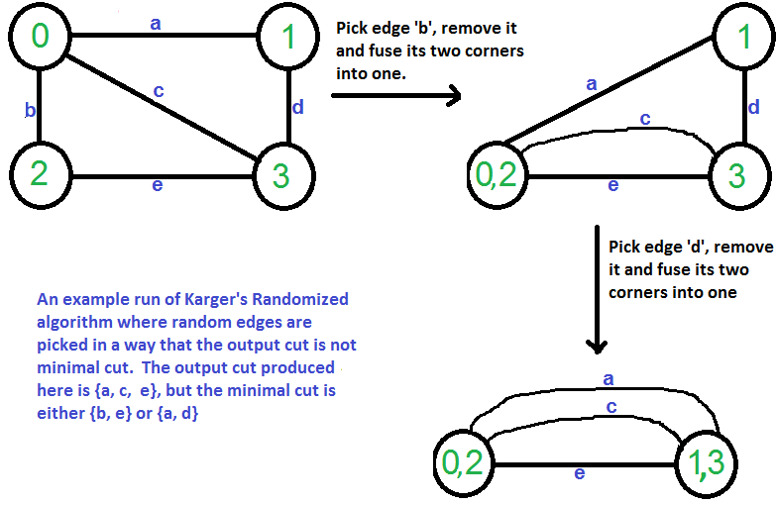
Karger's algorithm

